Slide 1

THE IMPACT OF COVID-19 ON THE GLOBAL ECONOMY.
……………………………………………………………………………..

Slide 2
INTRODUCTION
Description : The COVID-19 pandemic tossed the world into a state of uncertainty, not only from the health standpoint but also on global economy. With the global that were enacted requiring many businesses to shut down early and limiting the number of people engaged in gathering activities, this took a toll on the level of consumption and total output that builds a country’s economy. Our interest in this topic pertains to our willingness to explore the different ways and to what degree ecological forces like the global COVID-19 pandemic can affect a country’s economy both short and long term.

Slide 3
QUESTIONS THE TEAM HOPES TO ANSWER WITH THE DATA.
Which countries were most and least affected by COVID-19?
What income group the countries affected fall into?
Is GDP per capital a determinant of cross-country differentials in impact of COVID-19?
Is HDI a determinant of cross-country differentials in impact of COVID-19?
Is population size a determinant of cross-country differentials in impact of COVID-19?

Slide 4
CCC
PS: Which countries were most and least affected by COVID-19?
The top ten most and least affected countries based on the total cases and total death are as shown below:

Slide 5
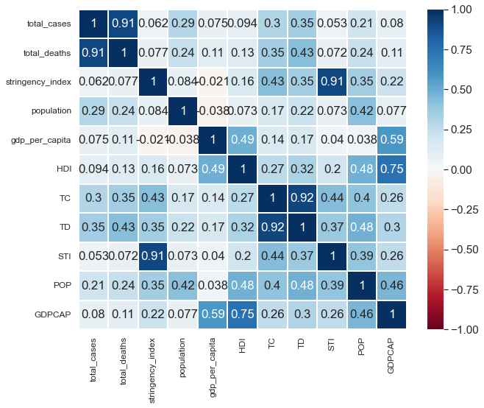
Correlation Analysis Chart

Slide 6
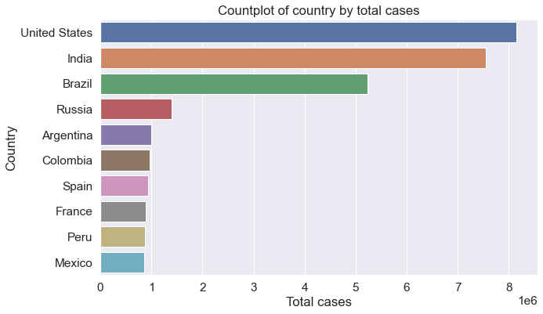
Top Ten Most Affected Countries by Total Cases

Slide 7
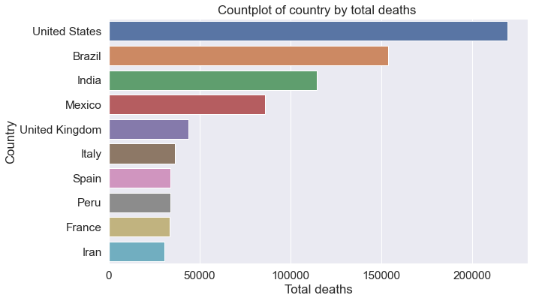
Top Ten Most Affected Countries by Total Deaths

Slide 8
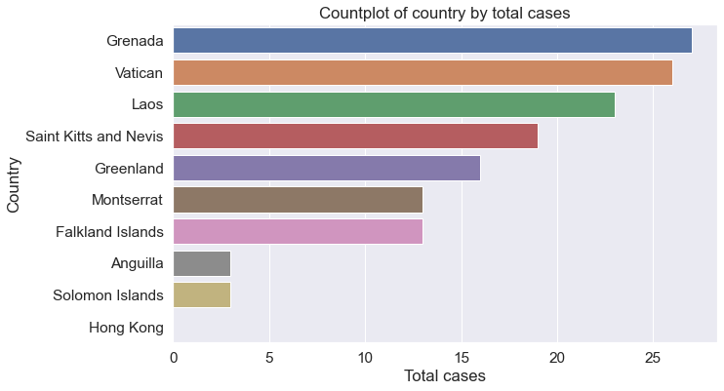
Top Ten Least Affected Countries by Total Cases

Slide 9
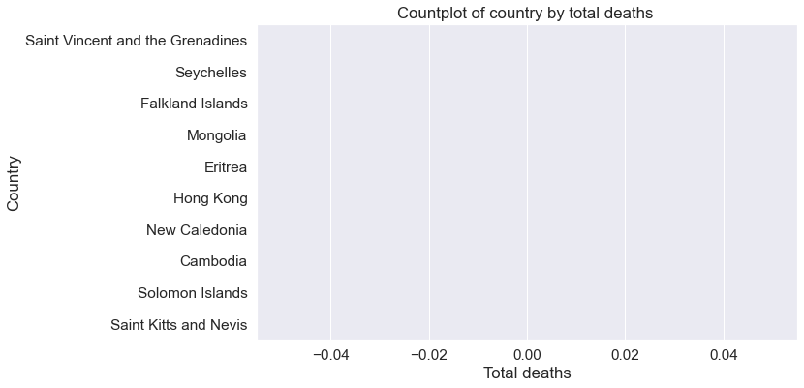
Top Ten Least Affected Countries by Total Deaths

Slide 10
CCC
PS: What income group the countries affected fall into?
The countries were grouped based on the GNI per capita and their counts were taken as shown below:

Slide 11
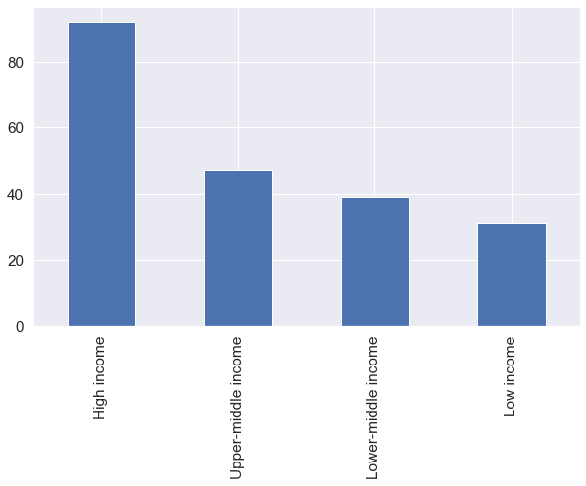
Graph showing the value count of the income groups

Slide 12
CCC
PS: Is GDP per capital a determinant of cross-country differentials in impact of COVID-19?
GDP per capita produces slight changes across the countries as shown below:

Slide 13
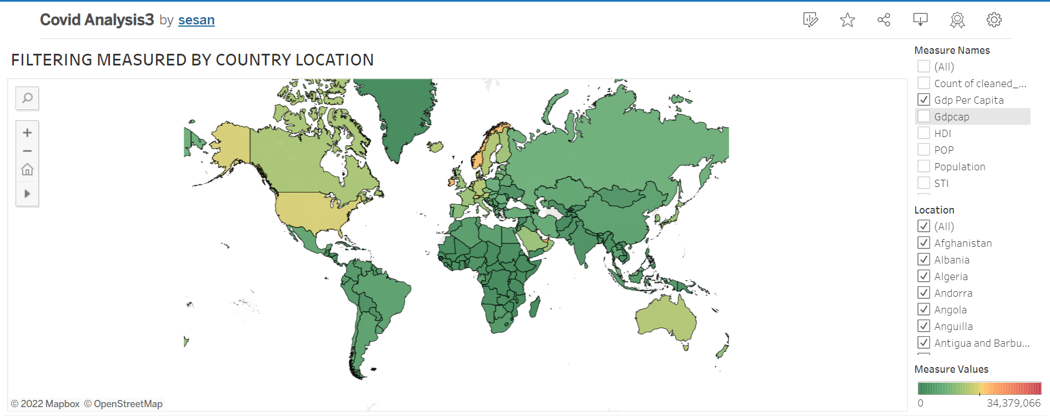
Map showing changes by GDP per capita

Slide 14
CCC
PS: Is HDI a determinant of cross-country differentials in impact of COVID-19?
HDI produces major changes across the countries as shown below:

Slide 15
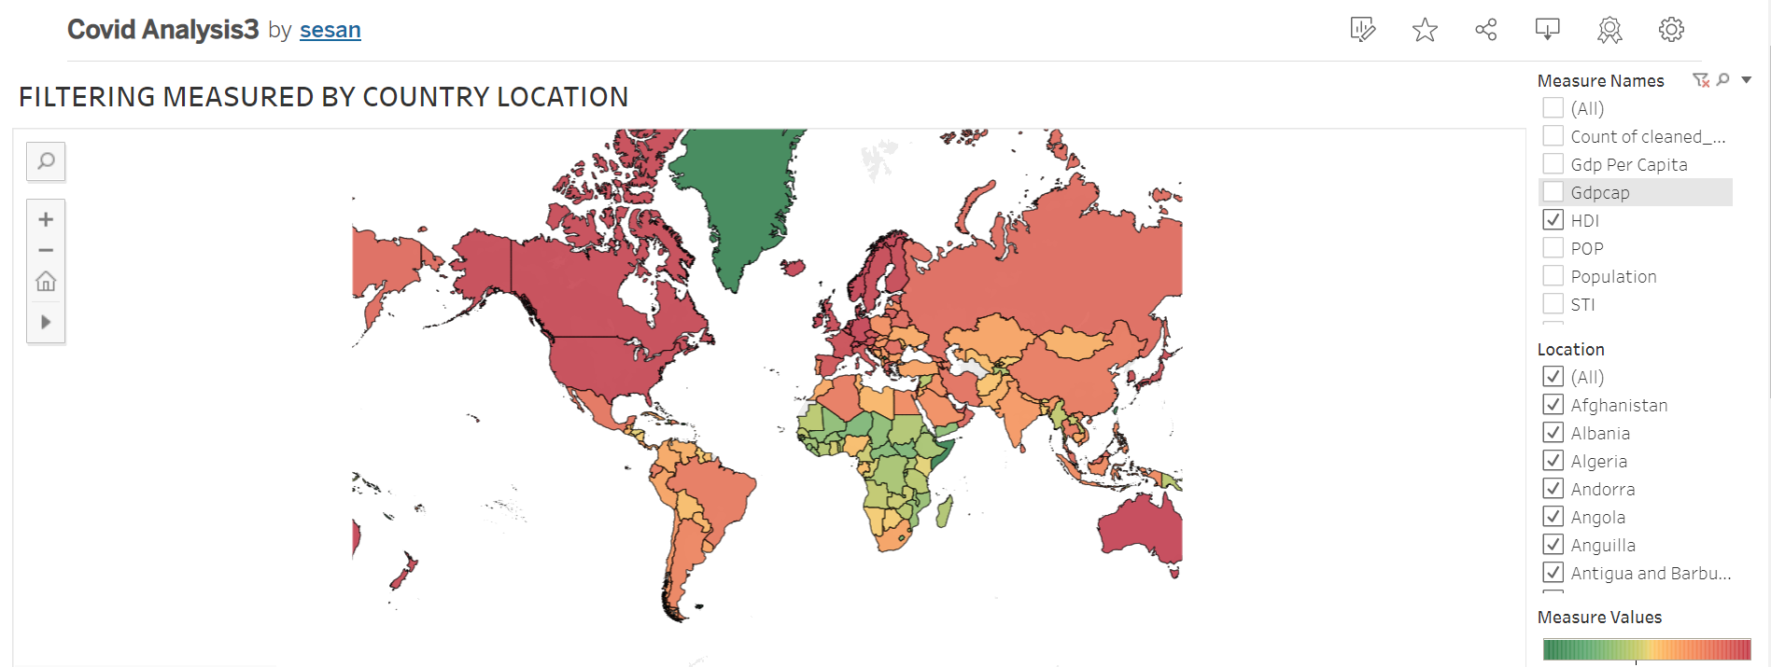
Map showing changes by HDI

Slide 16
CCC
PS: Is population size a determinant of cross-country differentials in impact of COVID-19?
Population size was greatly affected by the COVID-19 across the countries as shown below:

Slide 17
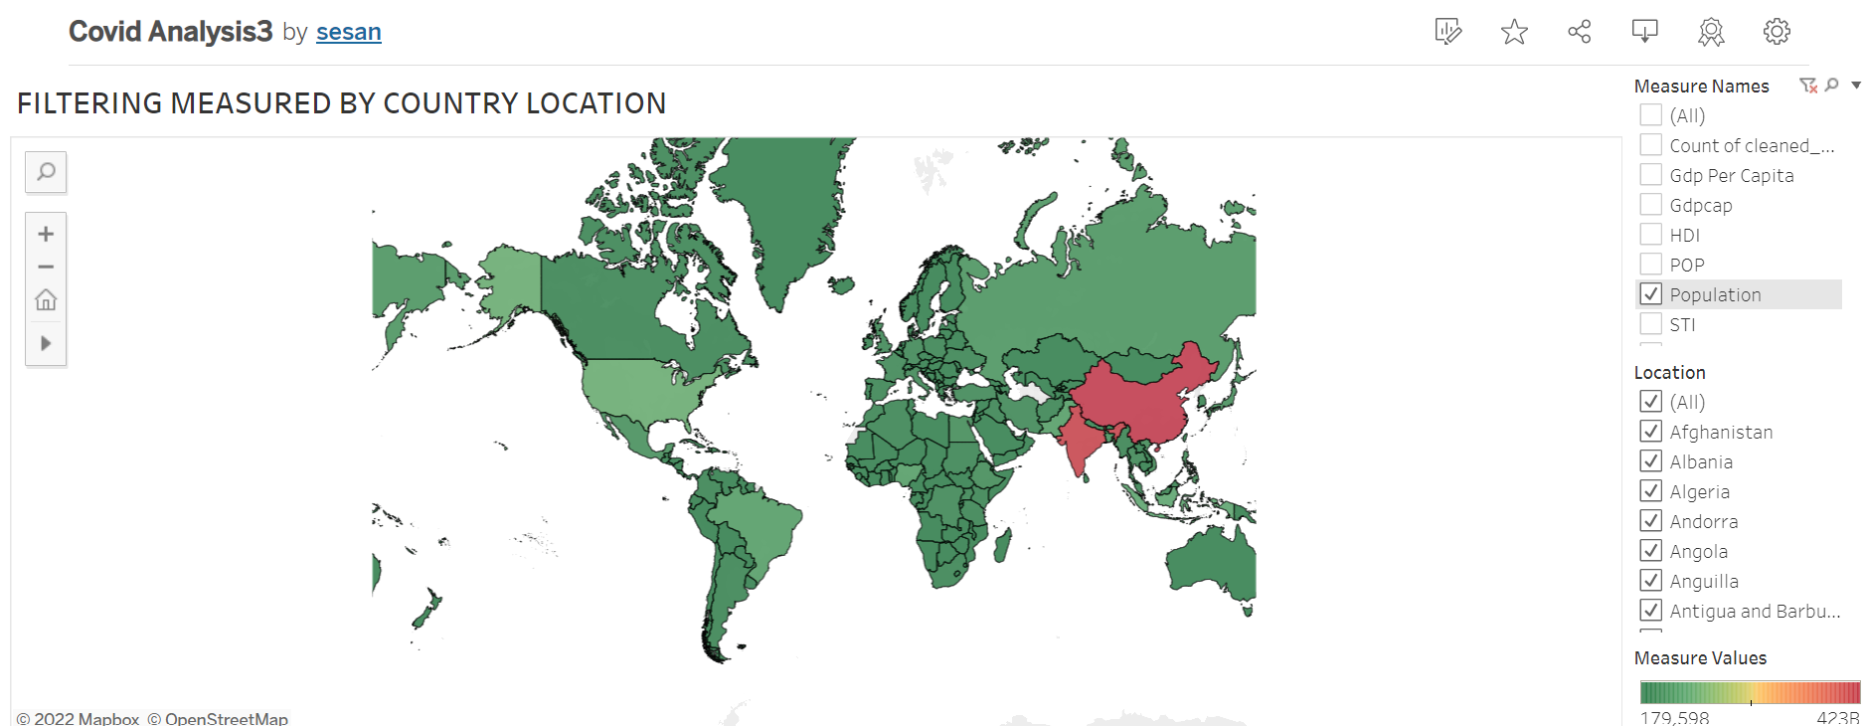
Map showing changes by Population size

Slide 18
CONCLUSION
As seen in the analysis, the COVID-19 pandemic had a great impact on the world’s economy in negative ways. The maps and the charts also showed how the pandemic affected the GDP per capita, HDI and the population size generally.
However , in the final stage of the project the following softwares would be used to analyse and create our dashboard, viz:
1, Tableau
2. Python/Pandas

Slide 19
Thank You!

